Slide 1

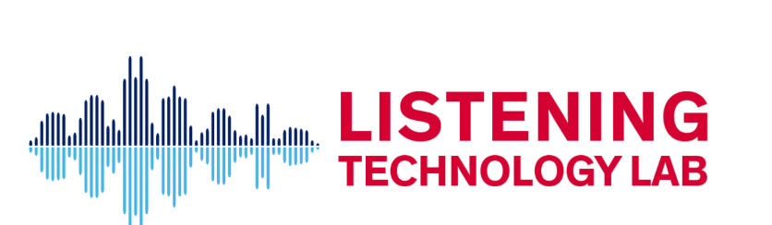
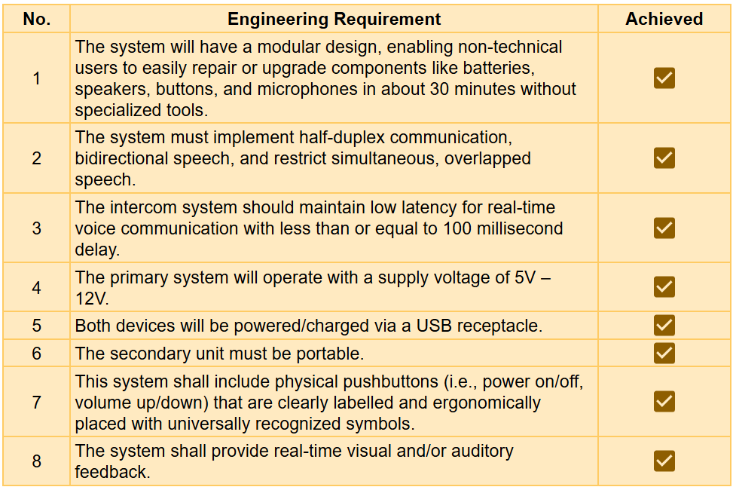
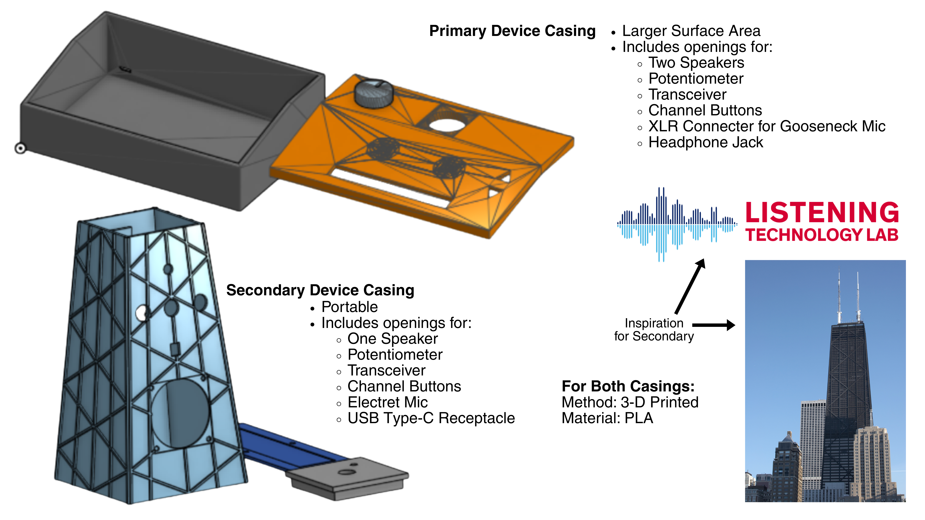
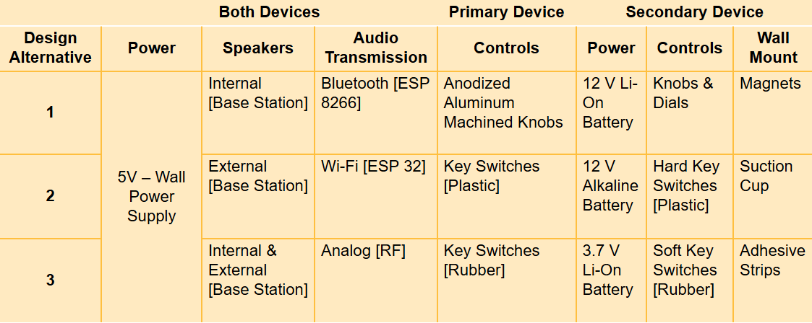
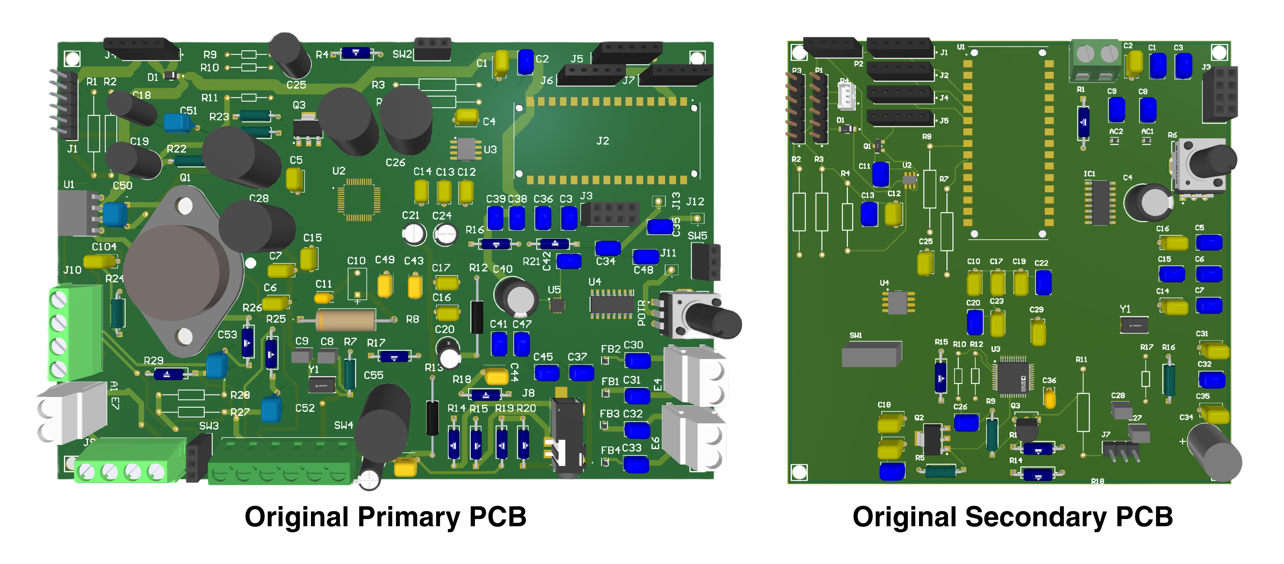
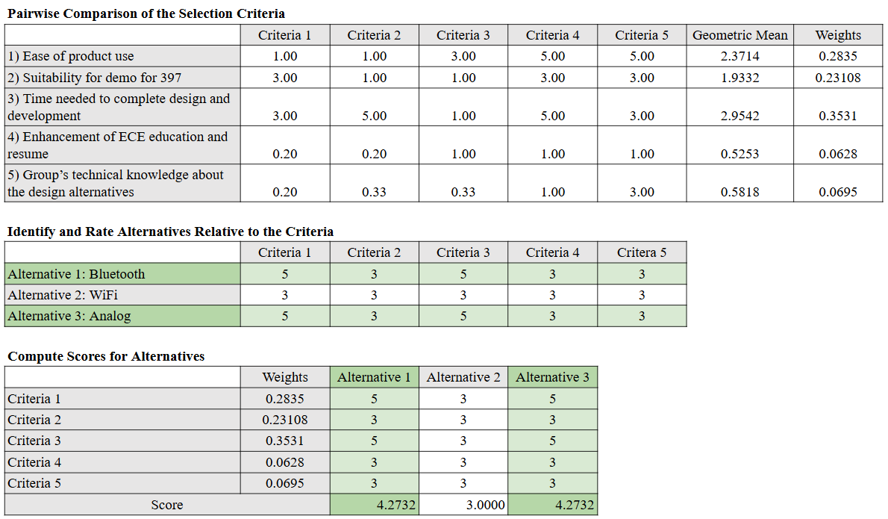
AcoustiQ: Acoustic Chamber Intercom
Kayla Gardner, Nikolas Gonzalez, Neftaly Lara, Moises Loera Martinez, Thomas Tran
Dr. Ryan Corey
Abstract
Engineering Requirements
Materials
Results
Our interdisciplinary team, collaborating closely with Dr. Ryan Corey, the director of the Listening Technology Lab (the Lab), is currently developing an innovative wireless communication system intended to replace the outdated Motorola PIP11 Audio Monitor currently utilized in the acoustic chamber. This new system, named AcoustiQ, aims to enhance the functionality of the Lab while advancing research initiatives at both UIC and the Discovery Partners Institute. The existing audio monitor is limited by inadequate sound quality and functionality, primarily due to the chamber's meticulously engineered sealed construction and robust steel walls, which interfere with its Bluetooth connectivity and voice transmission. The user interface of the PIP11 is unintuitive making device pairing difficult and time-consuming. AcoustiQ provides reliable half-duplex audio transmission between an external observation unit and an internal device located within the chamber, maintaining the chamber’s integrity throughout its use. In our design, the external device continuously receives and processes audio signals from a secondary unit inside the chamber when activated, with a focused emphasis on enhancing the intelligibility of human speech sounds—an essential component for effective communication during research sessions. To enhance usability, there is an option to select from three LED indicator buttons corresponding to the clearest and least congested frequencies within the 2.4 GHz band, optimizing their auditory experience. Additionally, the system includes a push-to-talk feature that enables researchers outside the chamber to communicate with participants inside, active solely during specified communication to eliminate any background noise. The design incorporates audio output capabilities to headphones and internal or external speakers, catering to a diverse array of research requirements and preferences. The materials used for construction, sourced from the UIC Makerspace, are selected for their durability and reliability, ensuring the system can withstand extensive use. Importantly, our design prioritizes user-friendliness and seamless connectivity. We anticipate the intercom system will maintain low latency for real-time voice communication with less than a 100-millisecond delay. By focusing on enhancing audio clarity while minimizing noise interference, we aim to create an effective communication tool that is both cost-effective and scalable, effectively addressing the limitations of existing consumer-grade solutions. It not only represents a significant technological advancement for the Lab but also sets a new benchmark for research in auditory technology.
After completing our Altium schematics and PCB production, we verified that the connection routing between the NRF24L01+PA+LNA and the Arduino Nano ESP32 functions effectively. Our unit testing involved utilizing the transceiver, electret microphone, and microcontroller. We routed the microphone to the microcontroller to serve as a digital-to-analog converter (DAC), allowing sound output to speakers. To ensure consistent power delivery at 5V, we selected passive components that perform well under high power conditions, and our observations confirmed an appropriate response. Additionally, we provided multipurpose serial outputs for the microcontroller and transceiver. The microcontroller includes LED indicator buttons that confirm connectivity when pressed, assisting in the selection of the 2.4 GHz frequency. However, we encountered some audio limitations that affected the clarity of speech, resulting in subpar sound quality. To address our engineering requirements, we implemented a modular design that facilitates easy debugging and repair of passive components, such as batteries and LED pushbuttons. Power delivery is facilitated through a USB receptacle, accommodating input voltages between 5V and 12V, and this setup also supports phantom power capabilities. The system operates on a half-duplex communication model, which provides auditory feedback.
.
Transceiver: NRF24L01+PA+LNA
Audio Processor: ADAU1701JSTZ-RL
Audio Amplifier: PAM8406DR
Microcontroller: Arduino Nano ESP32
Gooseneck Microphone: Behringer TA312S
Electret Microphone: MAX4466
Headphone Amplifier: MAX97220
Headphone Jack with Switch: SJ-43515RS-SMT-TR
Power Path Controller: LTC4412HVIS6#TRPBF
Boost Converter: XL6009
Memory: EEPROM
Passive Components
RED: Selection required modification.
Methodology
Voice is captured using either a Behringer TA312S gooseneck microphone (primary) or a MAX4466 electret microphone (secondary).
A pre-amplified mic signal is sent to the ADAU1701JSTZ-RL which manages gain, filters, and microphone mode selection (push-to-talk, mute, hot mic).
Processed audio is then transmitted wirelessly using the NRF24L01+PA+LNA transceiver over the 2.4 GHz band.
Pushbuttons allow the user to select between three communication frequencies.
On the receiving side, the audio is processed again by a second ADAU1701JSTZ-RL.
The output is amplified using either a PAM8406 speaker amplifier (for both options) or a MAX97220 headphone amplifier (primarily).
An Arduino Nano ESP32 controls switching, input logic, and communication handling.
Prototypes
Casings
Conclusion
Initially, we experienced significant delays in generating our printed circuit boards (PCBs) as our team was learning the capabilities of Altium software and understanding the requirements for PCB manufacturing. We also encountered budgeting issues due to the limited funding of three hundred dollars, necessitating supplemental funds for ordering passive components and submitting our PCBs to the JCL PCB manufacturer. Despite these challenges, we found opportunities to innovate and problem-solve. We utilized supplies available in the senior design laboratory and received generous contributions to support our purchasing needs, both from independent sources and our advisor. Our project, which is focused on developing a wireless communication system, faced setbacks during testing. The initial low-cost, sub-1 GHz transceiver, identified as CC1101, demonstrated shortcomings in transmission and reception. As a result, we decided to pivot to the NRF24L01+PA+L transceiver to achieve reliable bi-directional wireless communication with our microcontroller, the Arduino Nano ESP32. Our responsibilities included designing multiple subsystems to work in conjunction with both the external base station and the internal device. We have made foundational progress toward creating an operationally reliable system that meets most of our engineering requirements. Work is still ongoing, and we will continue to refine our design to deliver a complete and satisfactory product.
Introduction
The Acoustic Chamber Intercom is designed to enable clear and reliable communication in acoustically isolated research environments, such as the Listening Technology Lab. Current consumer-grade baby monitors, used as a workaround, suffer from poor audio clarity, limited functionality, and interference due to the chamber's sealed construction and steel walls. These limitations hinder effective auditory research and real-time interaction between researchers and participants.
To address these issues, our system provides continuous audio monitoring and push-to-talk functionality, allowing for reliable half-duplex communication. Our design incorporates:
Wireless Transceiver (NRF24L01+PA+LNA)
Ensure robust communication through the steel chamber.
Digital Signal Processor (DSP) (ADAU1701JSTZ-RL)
Filters and enhances speech clarity while minimizing noise and feedback.
Class-D Audio Amplifier (PAM8406)
Provides efficient and high-quality audio output.
Headphone Jack with Automatic Switching (SJ-43515RS-SMT-TR)
Enables seamless transition between speakers and headphones.
Electret Microphones (MAX4466), Dynamic Microphone (TA312S)
Captures high-quality voice input with adjustable gain.
Lithium-Ion Battery System with Charger Module (TP4056)
Supports portable operation with power management.
The system consists of two devices:
An external base station that transmits and receives speech for researchers.
A portable internal device designed for clear audio capture and transmission inside the chamber.
By focusing on user-friendliness, durability, and adaptability, our intercom system enhances research capabilities while providing a cost-effective and scalable solution. This technology will improve the functionality of the Listening Technology Lab and advance auditory research initiatives at UIC and the Discovery Partners Institute.
PCBs
Acknowledgements
Dr. Ryan Corey, Rashen Fernando (PhD student) and Rajesh Rameshbabu (PhD student) for their patience, support, and our participation in the Listening Technology Lab Acoustic Chamber
Dr. Renata Revelo Alonso, Anthony Flowers from ECE Project Labs, UIC Senior Design Laboratory and UIC Makerspace

